Slide 1


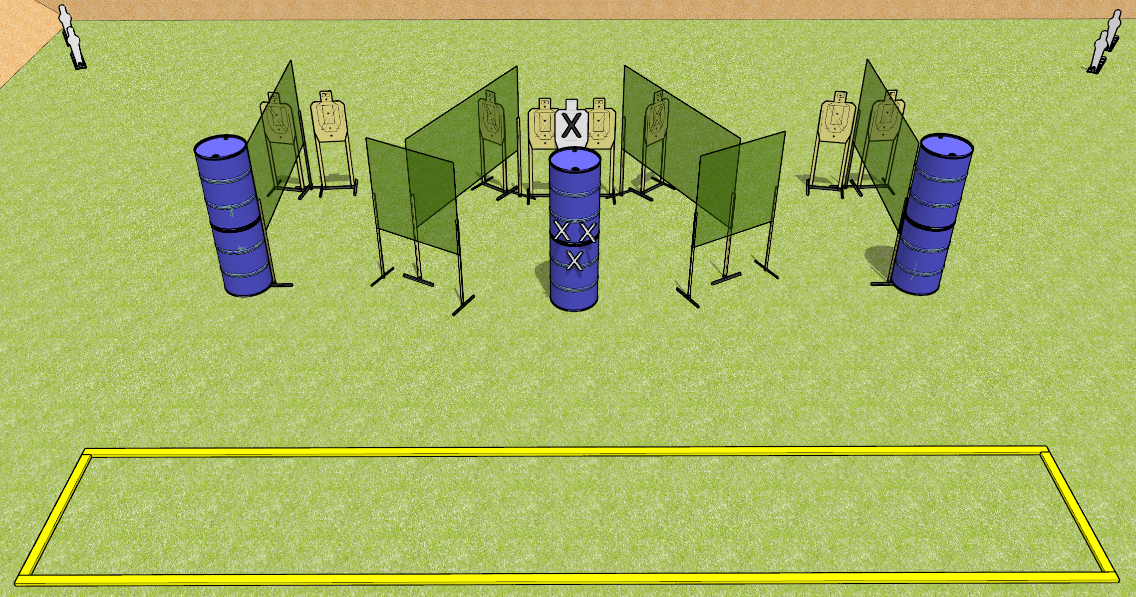
 | Dothan Gun Club – USPSA Match Go Fast! Course Designer : Drew Coleman
START POSITION : Standing with both hands touching marks on barrel. PCC muzzle touching lower mark.
GUN READY CONDITION : Pistol loaded and holstered. PCC loaded, shouldered, safety on. |  | SCORING: Comstock, 20 rounds TARGETS: 8 paper, 4 Steel SCORED HITS: Best 2 on paper, steel until down START-STOP: Audible, last shot RULES:
STAGE PROCEDURE: Engage targets as they become available from within the fault lines.

Slide 2
Go Fast!
Written Stage Briefing
Go Fast! is a 20 round, 100 point, Comstock Medium course. There are eight USPSA targets and four mini poppers. The best two hits on paper will score and steel must fall to score. The start signal is audible.
Handgun start position is standing with both hands touching upper marks on center barrel. Pistol is loaded and holstered.
PCC start position is standing with muzzle touching lower mark on center barrel. Loaded carbine is held with both hands, loaded, safety on.
Upon start signal, engage targets as they become available from within the shooting area.

